Slide 1
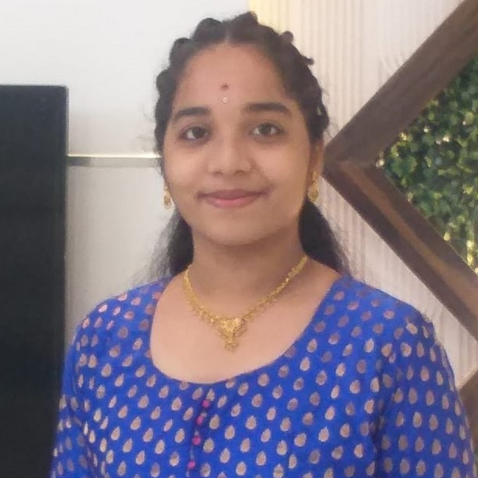


KOVVURI TEJASWI SAI KEERTHI REDDY
Associate/Software Associate
Bachelor of Science : 2019-2022 (Computer Science)
Certified in AZ-900 : Microsoft Azure Fundamentals.
Certified in AZ-104 : Microsoft Administrator
Bengaluru
kovvuri-tejsawi.sai-keerthi-reddy@capgemini.com
+91 8688558004
Skills:
A3
C# | Basics, OOPS, Exception Handling ,Arrays ,Collection and Generics.
.NET Framework | ADO.NET, .NET 6 WEB API, Entity Framework , ASP .NET with MVC5.
JAVA | Basics, OOPS.
Database | SQL .
Tools | GIT, POSTMAN, SWAGGER, VISUAL STUDIO CODE,VISUAL STUDIO,SSMS.
UI Technology | HTML5 ,CSS & Angular
Add On Skills | Communication Skills, Team Management
Azure & Full Stack Developer
Good Understanding of Azure Services.
Completed Az-900 Certification in Microsoft Azure.
Understanding of RDBMS concepts using SQL Server.
Practical understanding of C# and SQL concepts using Visual Studio and SQL Server
Hands on experience in developing applications using ADO.NET,.NET Core
Good understanding on basic concepts of Data structure (Linked List ,BST ,stack ,queue)
Developed a WEB APPLICATION (Crop Deal Online Application) as part of case study using .NET WEBAPI , & ANGULAR
.
Video Link: Click GitHub : Git Hub
This project is mainly used for farmers and dealers where farmer can easily post their crops with a fixed price and dealers can easily buy the crops by placing order, the main use of this project is farmer can get his expected price from their crops.
DEGREED
Successfully completed the degreed training in Git, HTML, CSS, SQL, C#, .NET Core, Angular.

